Slide 1

The Pilot Of Hadoop
2017.5
XenRon

Slide 2

CONTENTS
Preliminary Topics
事前準備
01
05
Hadoop Command
02
06
Hadoop Eco System
Reference Books
03
Hadoop Architecture
Hadoop Environment
実験環境
04

Slide 3
Forgetting Curve

Slide 4
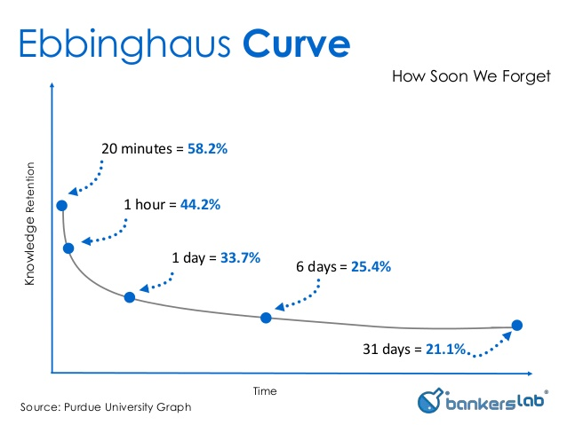
Forgetting Curve
Hermann Ebbinghaus

Slide 5
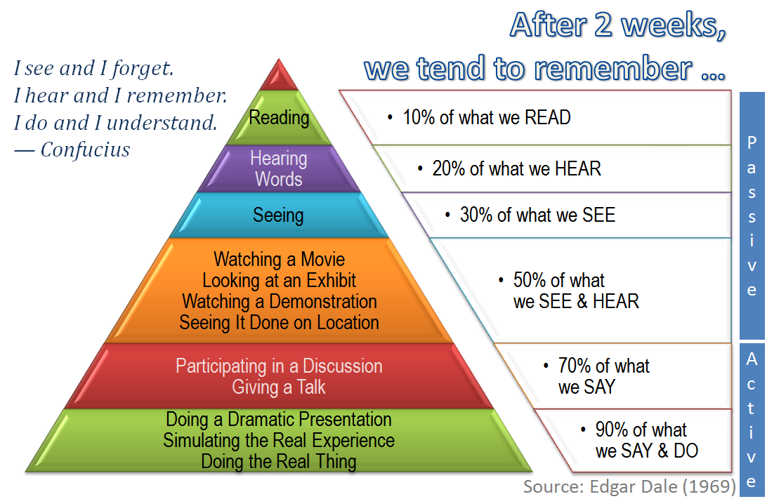
The Cone Of Learning

Slide 6
PART1
Preliminary Topics
事前準備

Slide 7
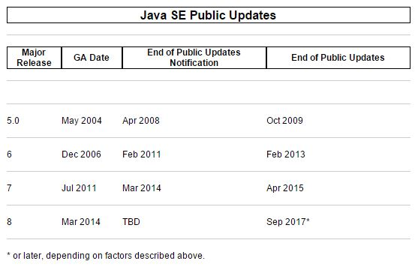

Java
http://www.oracle.com/technetwork/java/eol-135779.html

Slide 8
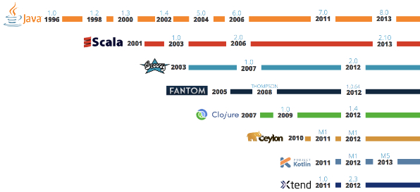
JVM

Slide 9



Linux
Official Website :
https://www.ubuntu.com/
http://releases.ubuntu.com/
Official Website :
https://www.centos.org/
https://www.centos.org/download/
https://wiki.centos.org/Download
Official Website :
https://www.redhat.com/en

Slide 10
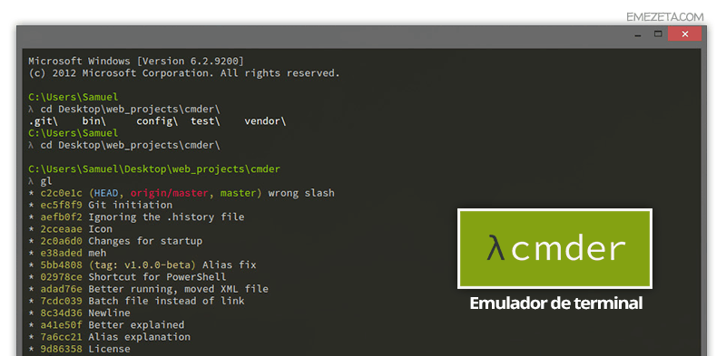
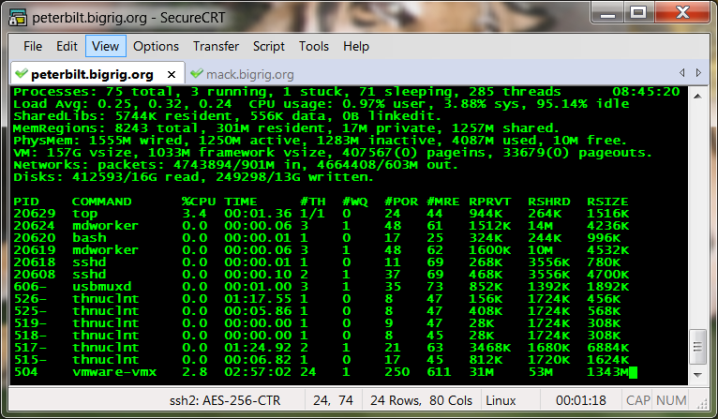
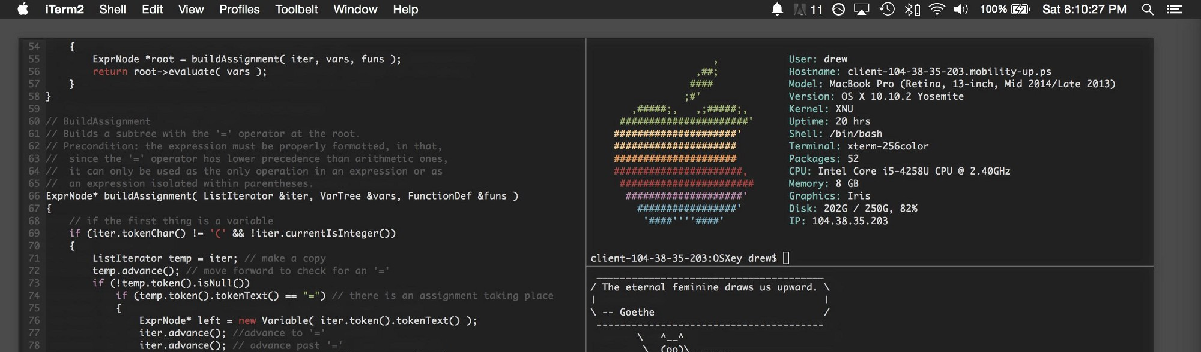
SSH Terminal

Slide 11





Virtual Machine

Slide 12
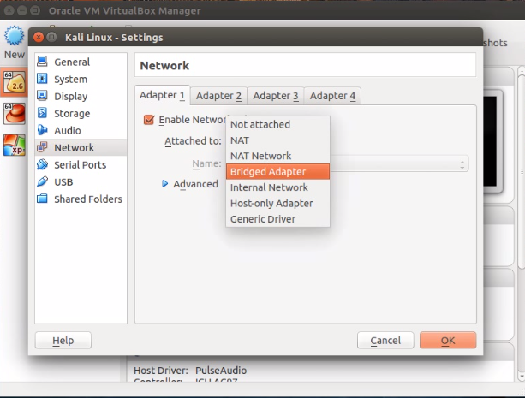
Virtual Box
Official Website :
https://www.virtualbox.org/
https://www.virtualbox.org/wiki/Downloads
Virtual networking :
https://www.virtualbox.org/manual/ch06.html

Slide 13
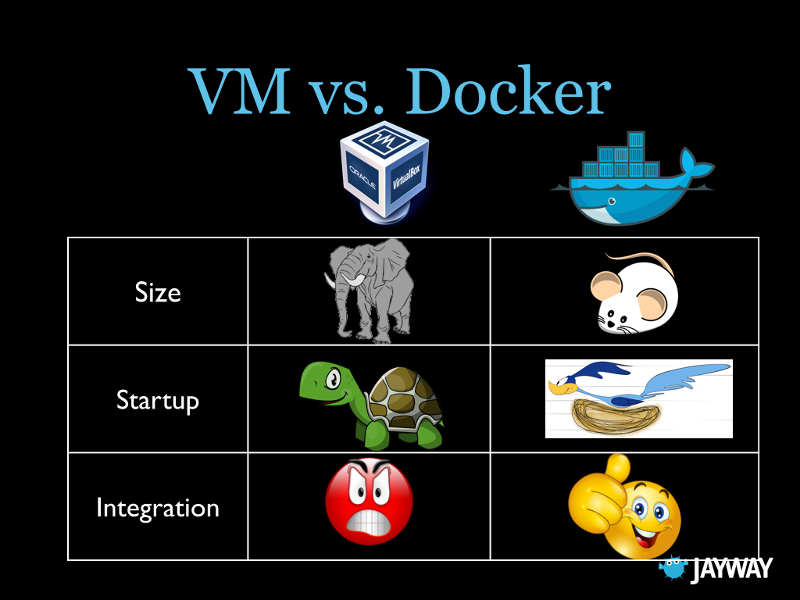
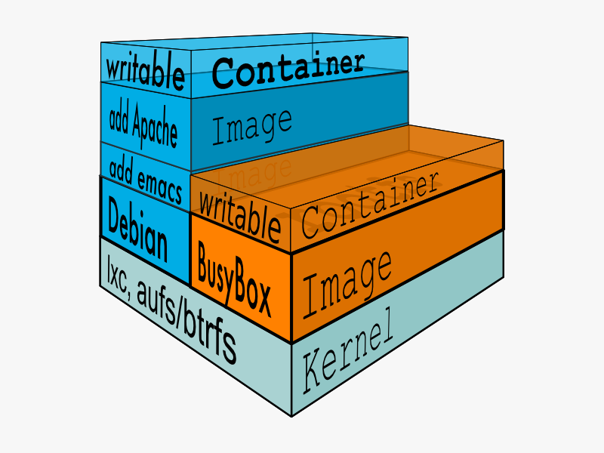
Docker

Slide 14
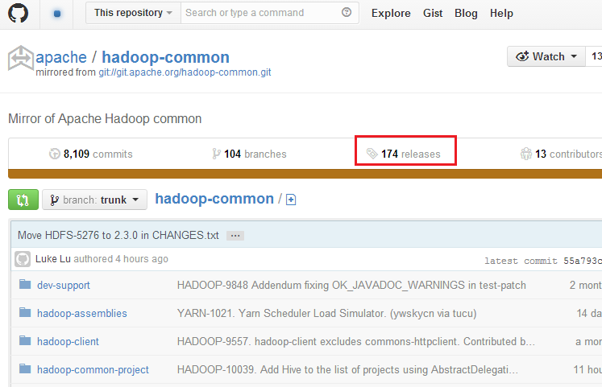

GitHub

Slide 15

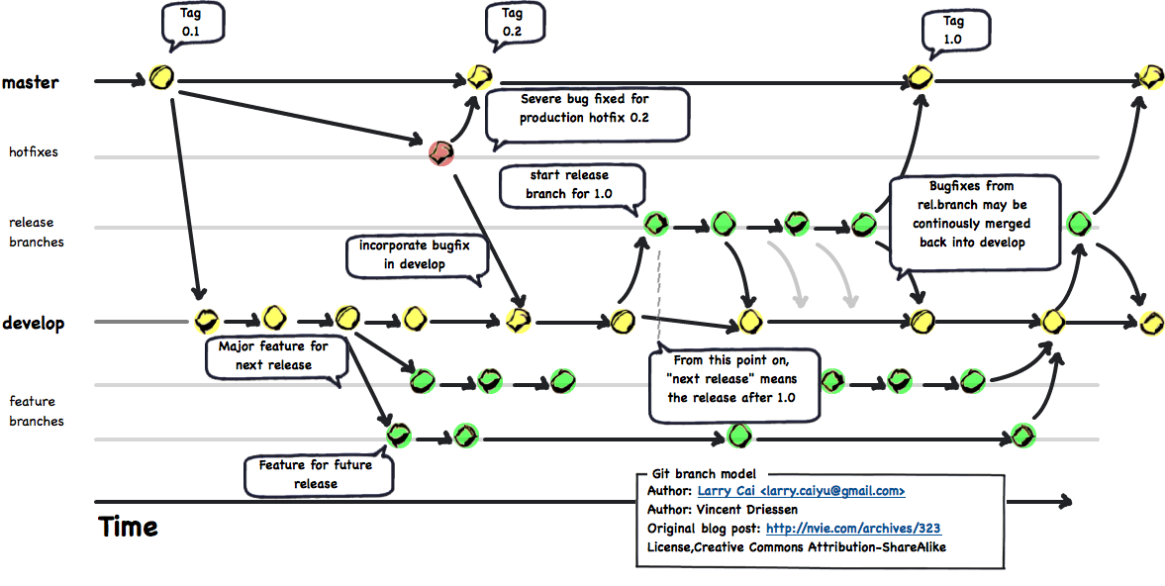
Git
Official Website :
https://git-scm.com/
The latest stable Release : v2.11.1

Slide 16
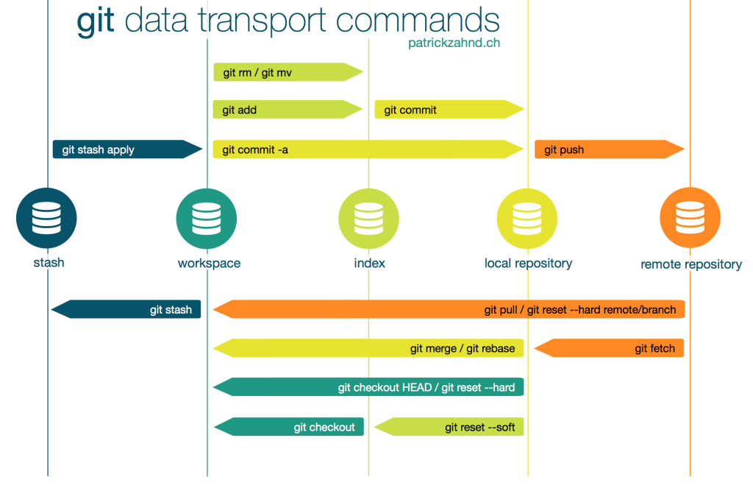
Git

Slide 17
PART2
Hadoop Eco System

Slide 18
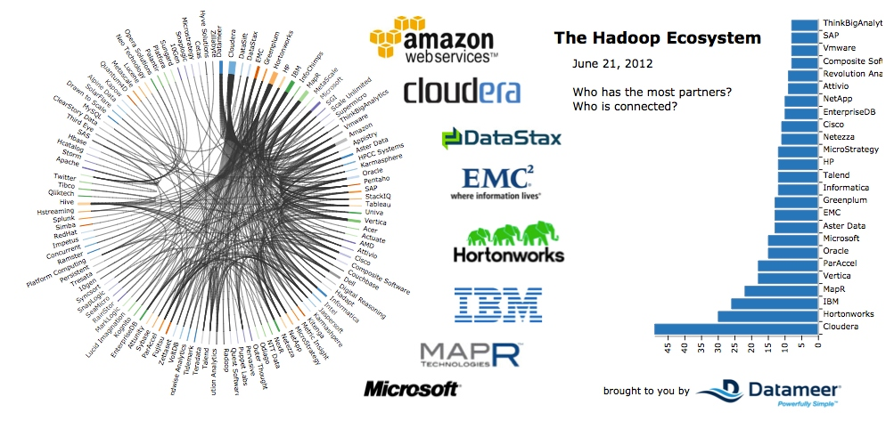
Distributions

Slide 19
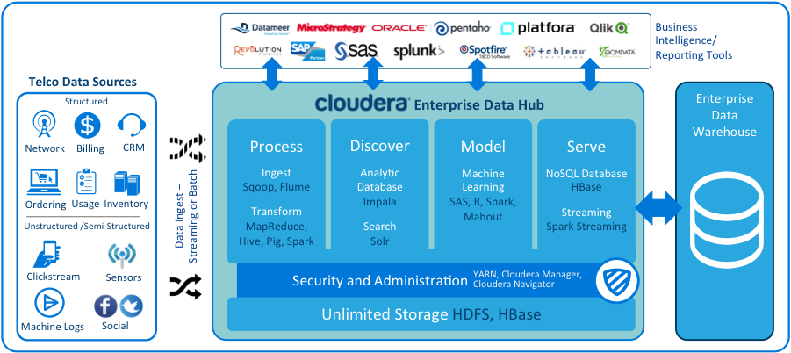
Cloudera

Slide 20
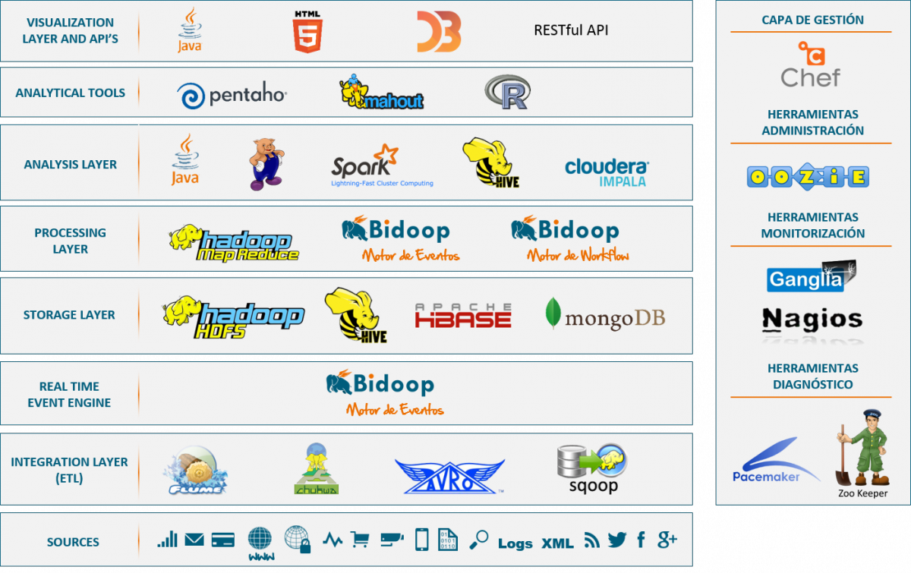
Hadoop Eco System

Slide 21
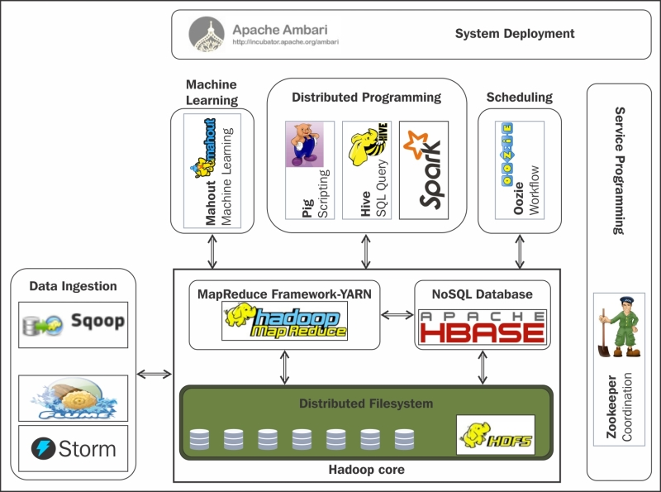
Hadoop Eco System

Slide 22
PART3
Hadoop Architecture

Slide 23
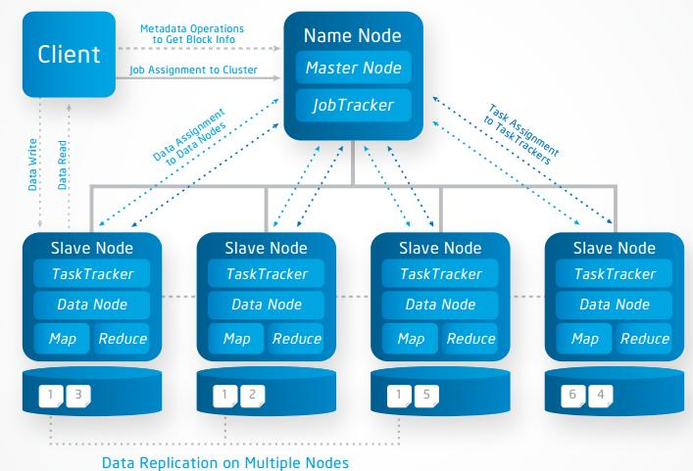
Architecture

Slide 24
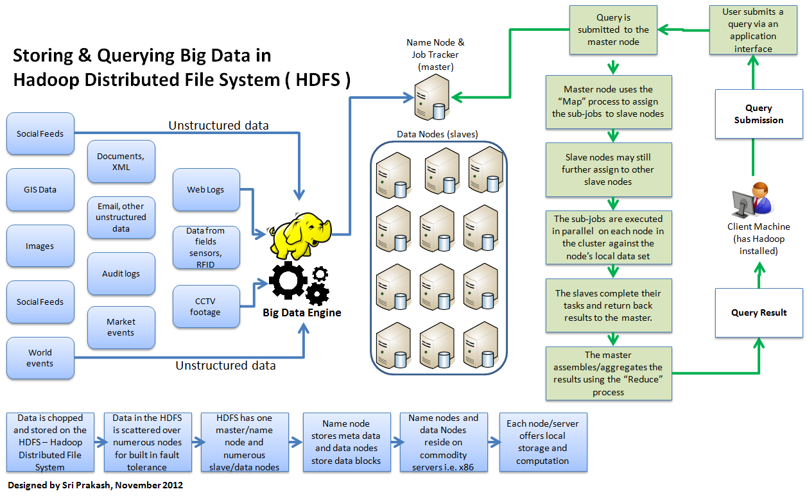
Architecture

Slide 25
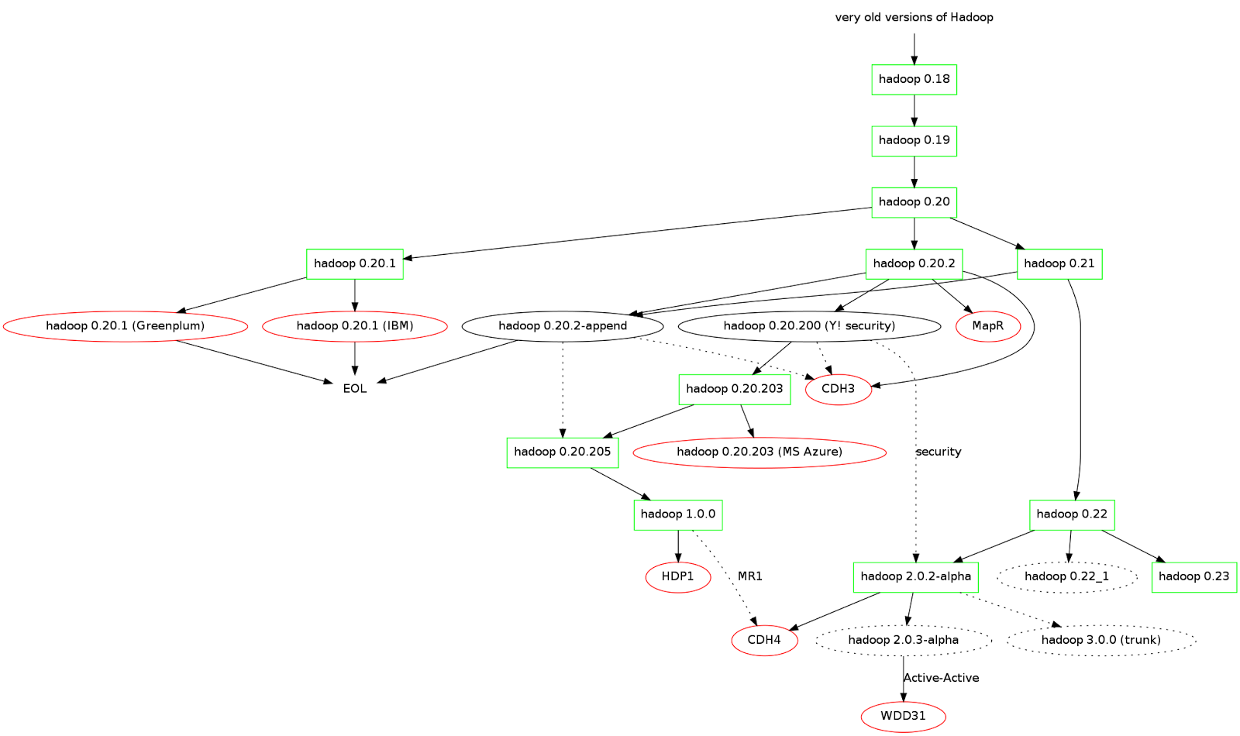
Apache Hadoop Version

Slide 26
PART4
Hadoop Environment

Slide 27
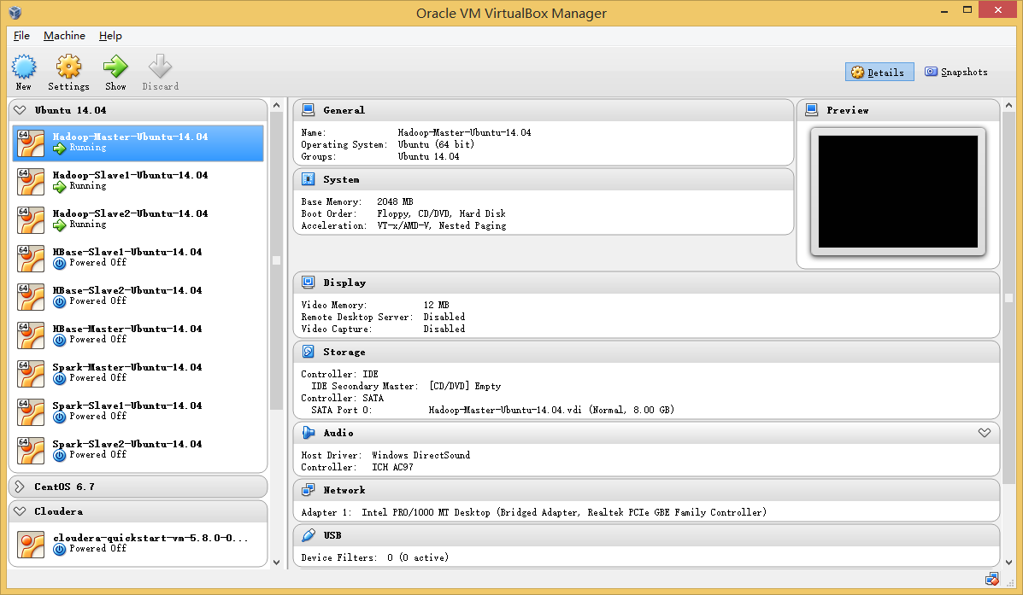
Oracle Virtual Box

Slide 28
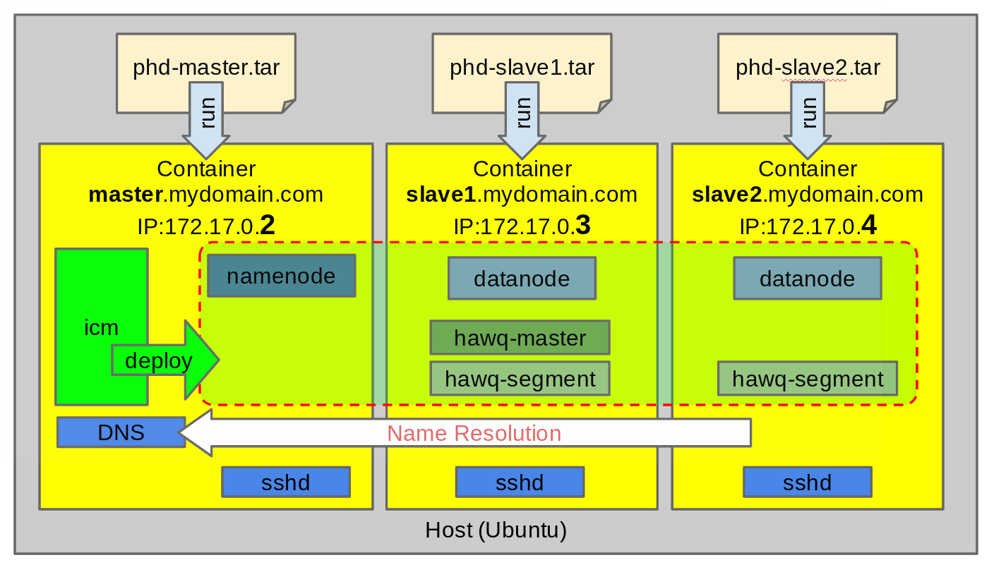
Docker

Slide 29
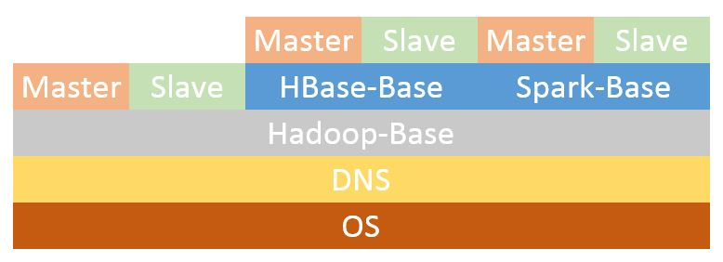
Docker

Slide 30
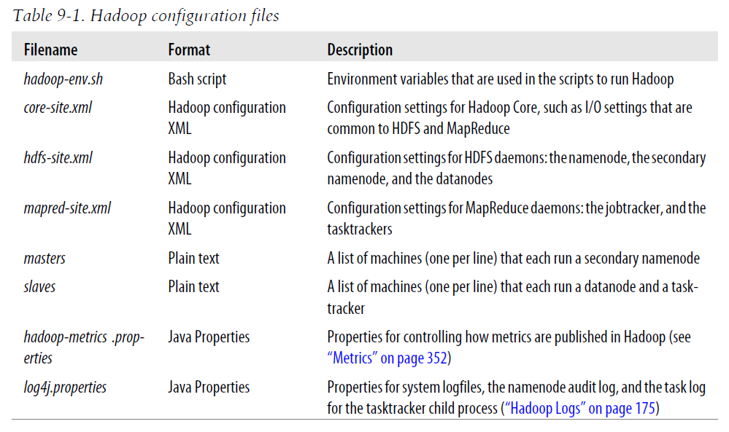
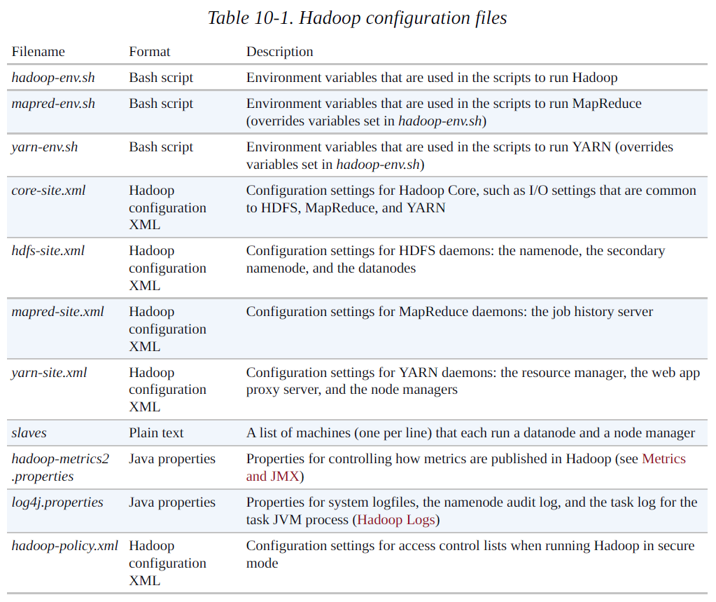
Hadoop configuration files
Hadoop 1.x
Hadoop.The.Definitive.Guide.3rd.Edition
Hadoop 2.x
Hadoop.The.Definitive.Guide.4th.Edition

Slide 31
PART5
HDFS & Hadoop Command

Slide 32
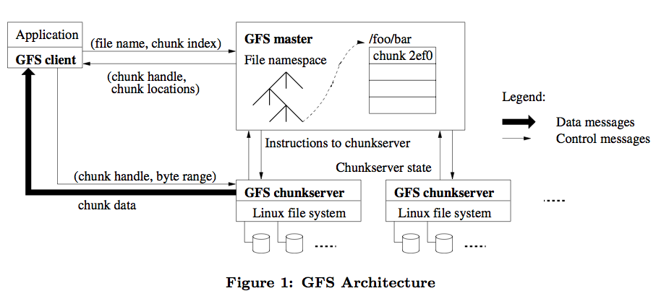
Google File System
The Google File System
https://static.googleusercontent.com/media/research.google.com/ja//archive/gfs-sosp2003.pdf

Slide 33
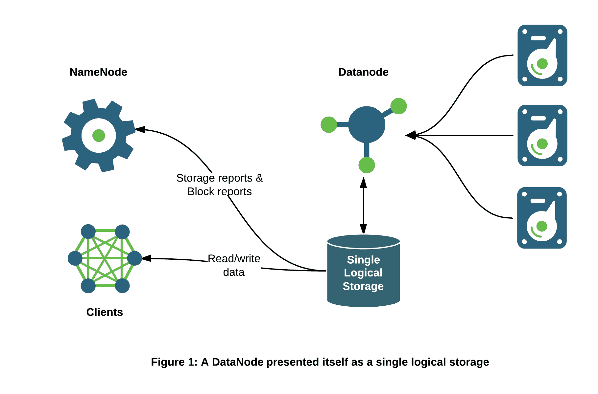
HDFS

Slide 34
HDFS

Slide 35
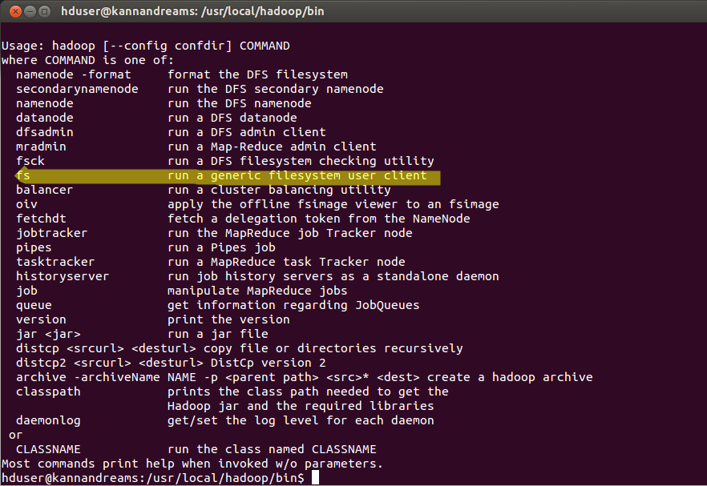
HDFS
Official Website :
https://hadoop.apache.org/docs/stable/hadoop-project-dist/hadoop-common/FileSystemShell.html
https://hadoop.apache.org/docs/r1.0.4/cn/hdfs_shell.html

Slide 36
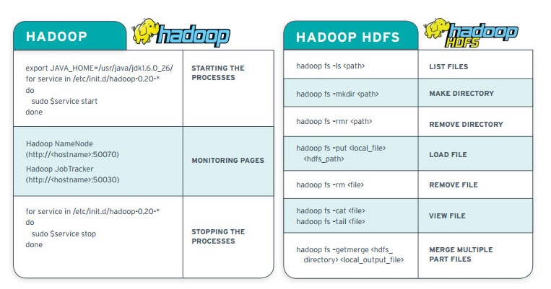
HDFS

Slide 37
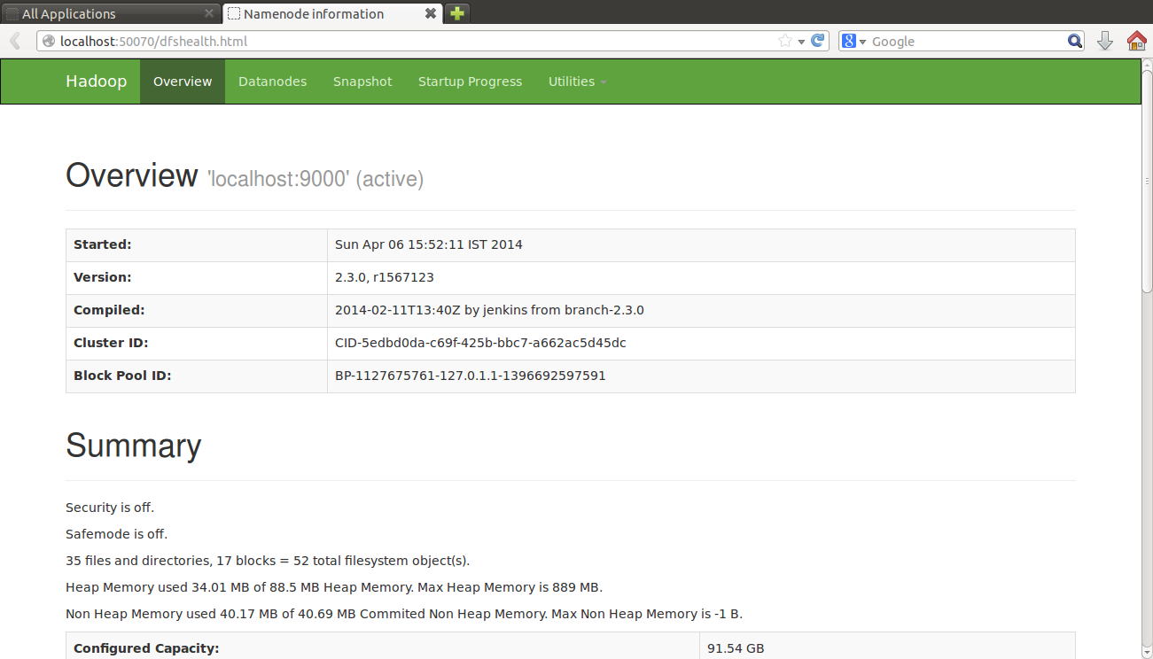
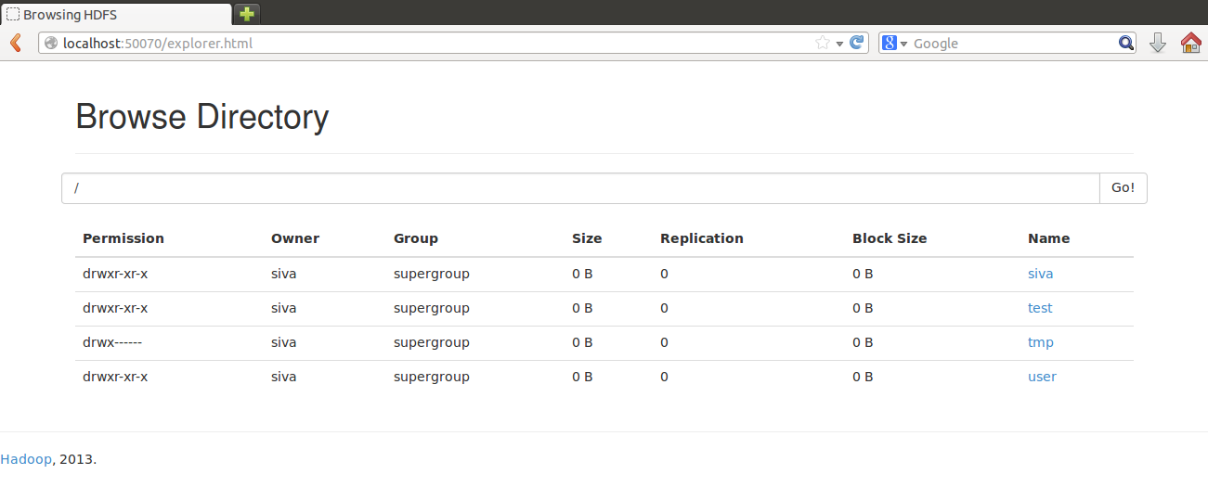
HDFS Web UI

Slide 38
PART6
Reference Books

Slide 39


Books

Slide 40
HomeWork

Slide 41
The End

